Slide 1

Wheat Crop Disease Detection and Analysis using Machine Learning
CMPE 295B -Master Project II
Project Advisor : Jerry Gao
Team members: Prashansa Evangeline Bonapalle
Pratiksha Ramrao Masalkar
Dipak Ramachandani,
Anuj Jigneshkumar Vakil

Slide 2
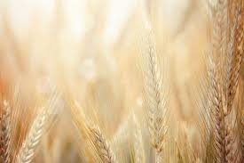
Introduction
Wheat is one of the most important crops globally, and detecting diseases early is crucial for maintaining high yields.
Traditional methods for detecting wheat diseases are often labor-intensive and not always accurate.
This project introduces a machine learning approach using YOLOv5 for detecting diseases in UAV imagery and VGG19 for classifying diseases from camera images.
These models help in automating the process, significantly increasing both the speed and accuracy of disease detection.

Slide 3
Dataset Overview
UAV Dataset:
Source: DJI Drone Imagery
Classes: Fusarium Head Blight Disease, Healthy Head
Total Images: Approximately 3100
Images were captured at various altitudes to simulate different field scouting scenarios.
Camera Dataset:
Source: Ground-based high-resolution camera
Classes: Crown and Root Rot, Healthy Wheat, Leaf Rust, Wheat Loose Smut
Total Images: Approximately 4,600
This dataset includes a diverse set of images taken in different lighting and weather conditions to robustly train the VGG19 model.

Slide 4
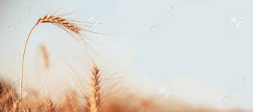
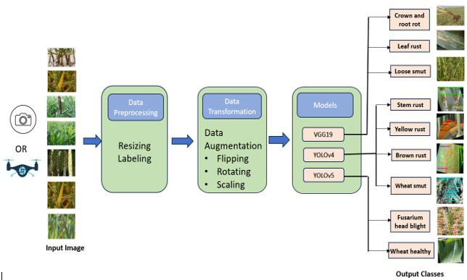
Wheat Crop Disease Detection Workflow
We begin with the acquisition of input images using cameras or drones, which are then resized and labeled during data preprocessing to ensure consistency and accuracy.
Data transformation employs techniques such as flipping, rotating, and scaling to augment the dataset, enhancing the robustness of the models against varying field conditions.
The processed images are fed into deep learning models like VGG19 and YOLO versions 4 and 5, which classify the images into different categories of wheat health, identifying various diseases and distinguishing healthy plants effectively.
Figure 1. Workflow

Slide 5
VGG19 Methodology for Wheat Disease Classification
VGG19 is a convolutional neural network that excels in classifying images by leveraging deep layers of learning.
For VGG19 we resized all input images to 224x224 pixels.
This model uses the Adam optimizer with a learning rate of 0.001 and is trained over 30 epochs to avoid overfitting while ensuring sufficient learning.
Data augmentation techniques such as rotations, zoom, shifts, and flips are implemented to enhance the model’s robustness against different agricultural field conditions.

Slide 6
YOLOv4 and YOLOv5 Methodologies for Wheat Disease Detection
YOLOv4 and YOLOv5 are advanced deep learning models designed for real-time object detection, crucial for localizing wheat diseases in UAV-captured images.
We resized images : 416x416 pixels for YOLOv4 , 640x640 pixels for YOLOv5 and normalized to enhance feature detection.
YOLOv4 is trained over an extensive 10,000 epochs with a batch size of 64 and a learning rate of 0.001, which is ideal for its intensive detection tasks.
YOLOv5, underwent training for 75 epochs with a batch size of 32 and starts with a learning rate of 0.01, reducing to 10% of this rate by the end of the training period.

Slide 7
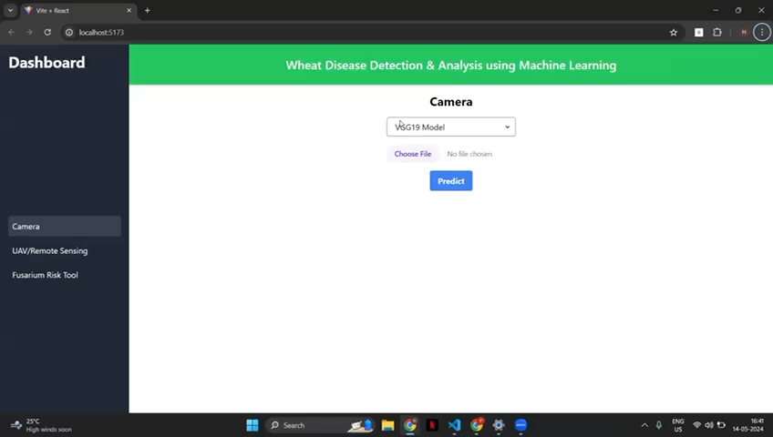
DEMO

Slide 8
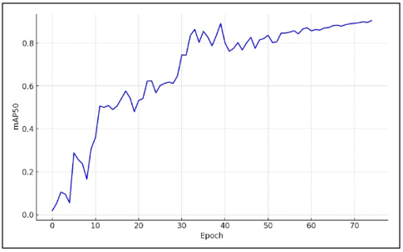
YOLOv5 Results
The YOLOv5 model demonstrated excellent performance in detecting and localizing wheat diseases.
Class | Precision | Recall | F-1 Score | mAP
Fusarium Head Blight | 0.94 | 0.96 | 0.95 | 0.93
Healthy Head | 0.93 | 0.92 | 0.92 | 0.91
Table 1. Evaluation Metrics Figure 2. mAP50 vs Epoch Graph for YOLOv5

Slide 9
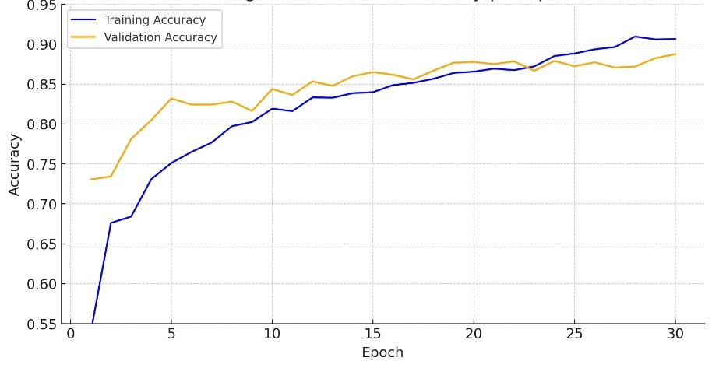
VGG19 Results
The VGG19 model has shown promising results in classifying different types of wheat diseases.
Class | Precision | Recall | F-1 Score
Crown and Root Rot | 0.88 | 0.90 | 0.89
Healthy Wheat | 0.95 | 0.97 | 0.96
Leaf Rust | 0.91 | 0.89 | 0.90
Wheat Loose Smut | 0.90 | 0.87 | 0.88
Table 2. Performance Metrics Fig. 3 Training and Validation Accuracy per Epoch

Slide 10
Comparative Analysis
VGG19 shows robust performance in wheat disease detection, achieving around 90% in precision and recall, with 92% training accuracy and 88% testing accuracy.
In contrast, YOLOv4 achieves 90% mAP@0.50, 80% precision, 83% recall, and an F-1 Score of 86.4%, indicating substantial improvements in specific metrics.
Meanwhile, YOLOv5 excels in targeted detection tasks, notably achieving a 96% F-1 Score for Fusarium Head Blight, reflecting its superior capability for specific conditions due to advanced model architecture and training optimizations.

Slide 11
Conclusion
Model Insights:
VGG19: Offers strong generalization across diverse conditions, ideal for broad-spectrum disease detection with high reliability.
YOLOv5: Best for targeted detection tasks, excelling in precision for specific diseases like Fusarium Head Blight, suitable for specialized applications.
Implementation Recommendations:
Use VGG19 for consistent, widespread disease monitoring.
Deploy YOLOv5 where detailed, precise disease identification is crucial.
Future Directions:
Model Enhancement: Expand training datasets and refine algorithms to boost model accuracy and robustness, facilitating their integration into real-time agricultural monitoring systems.
Model Customization: Strategically select and adapt models based on specific diagnostic requirements to optimize crop health management and resource utilization efficiency.

